Slide 1
Core Course
Generative AI
VIth Semester AY 2024-25
Chapter-4
Generative Models II: Autoregressive Models
(2-0-1)

Slide 2
Agenda:
Definition and Principle:
Autoregressive Property,
Conditional Dependence,
Autoregressive Process
Examples of Autoregressive Models:
AR Models in Time Series Analysis,
Autoregressive Integrated Moving Average (ARIMA)
Autoregressive Models for Generative AI:
(PixelCNN, WaveNet)- Overview, Architecture, Training, Applications

Slide 3
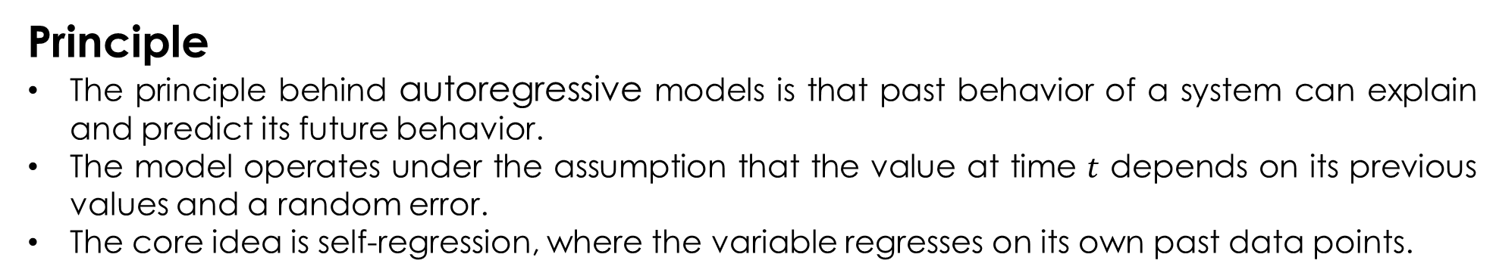
Definition and Principle
Definition
Autoregressive models are a class of machine learning models that automatically predict the next component in a sequence by taking measurements from previous inputs in the sequence.
They are statistical models used for time series analysis, where current values are predicted based on a linear combination of past values.

Slide 4
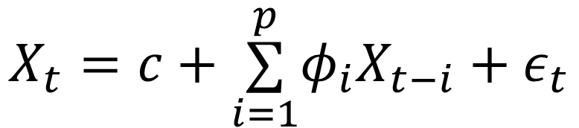
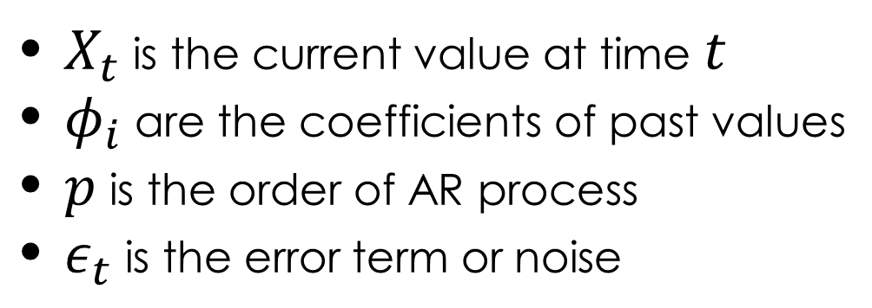
Autoregressive Property
The autoregressive property refers to the fact that the model’s predictions for future values are made only based on past observations of the same series.
In other words, an AR model assumes a direct dependency of the current value on its previous values.
This recursive dependence on past values gives the model its name "autoregressive."

Slide 5
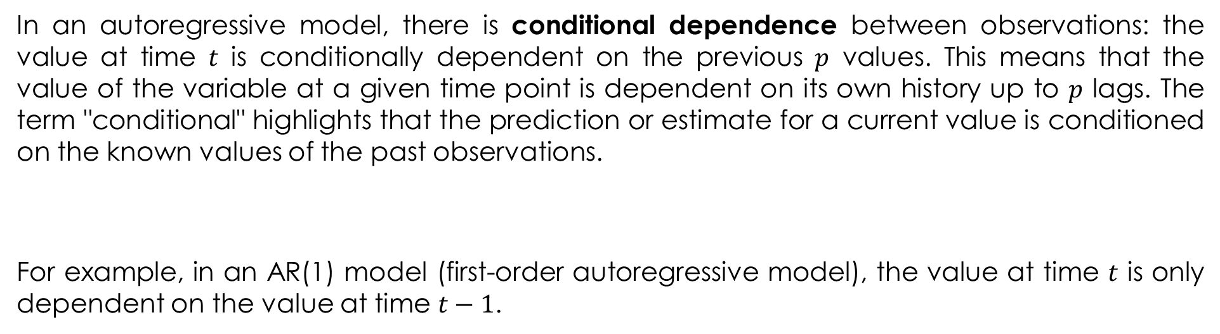


Conditional Dependence

Slide 6
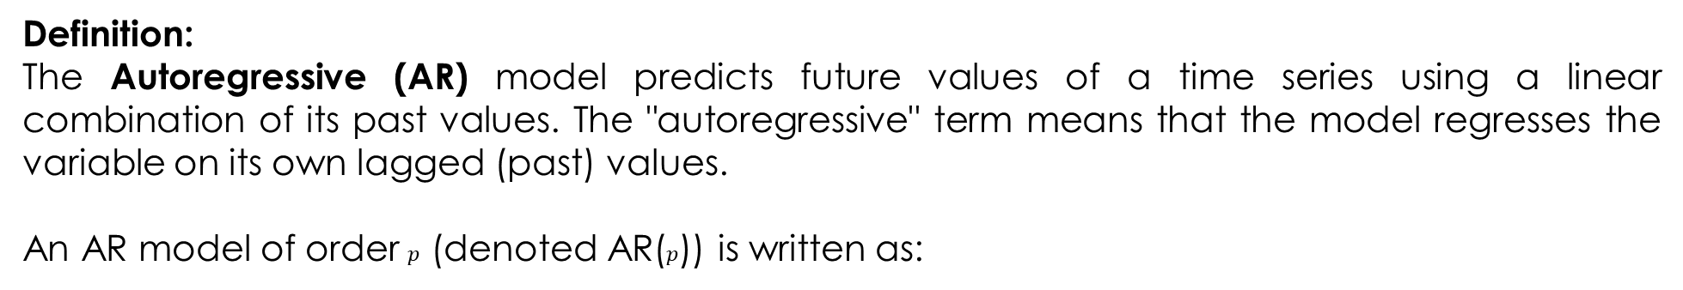
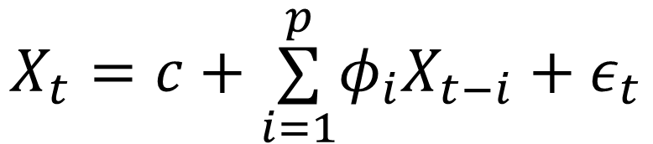
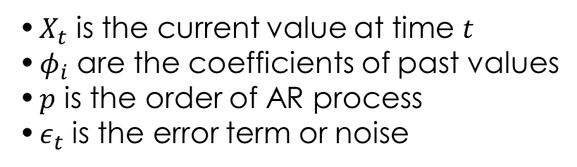
Autoregressive (AR) Model

Slide 7
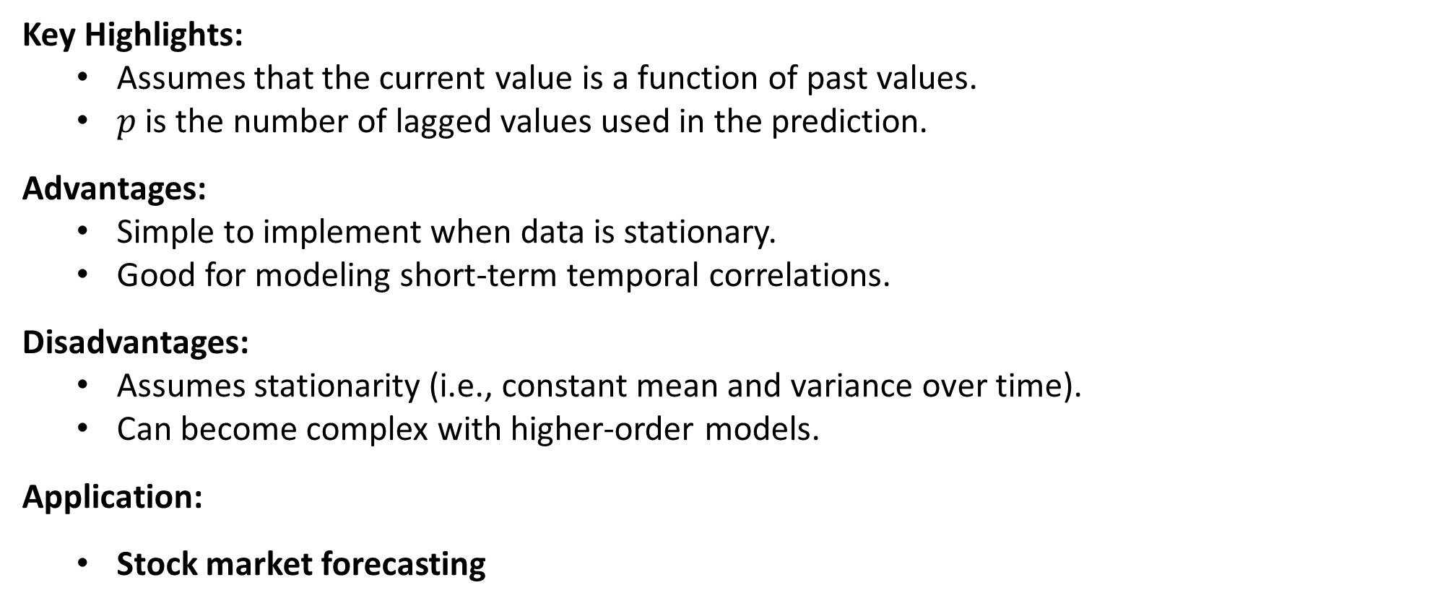
Autoregressive (AR) Model

Slide 8
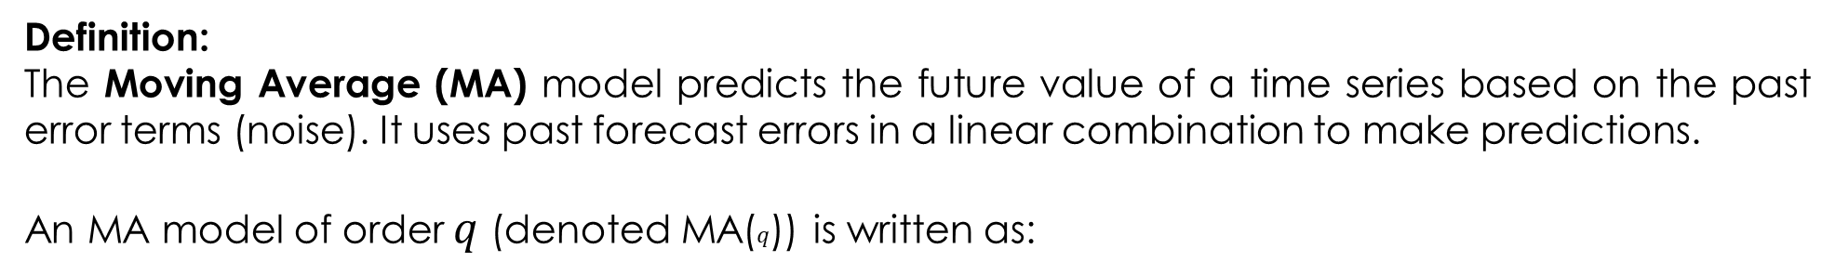
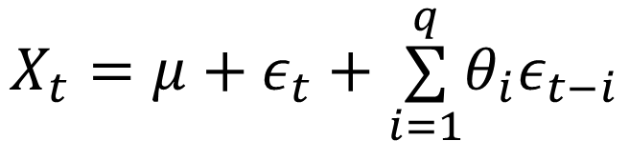
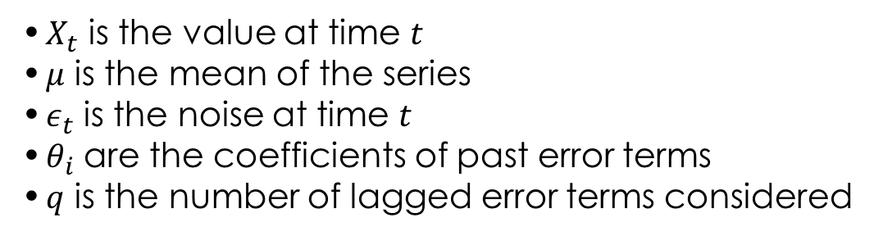
Moving Average (MA) Model

Slide 9
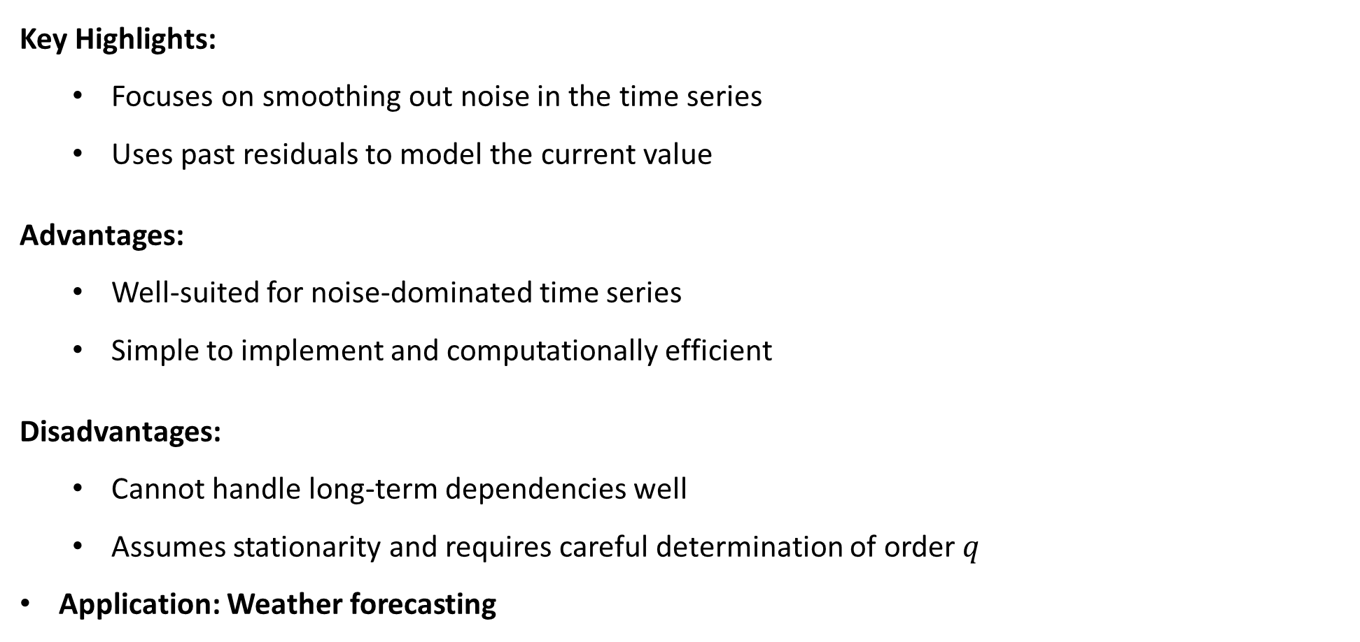
Moving Average (MA) Model

Slide 10
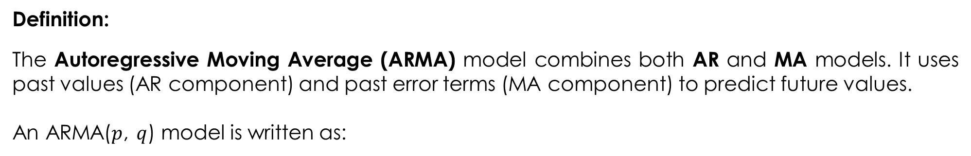
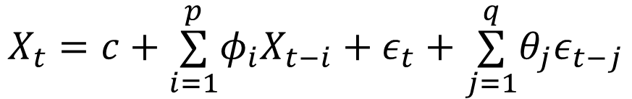
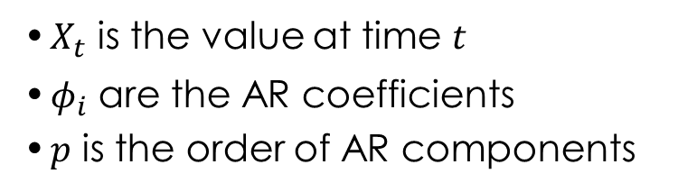
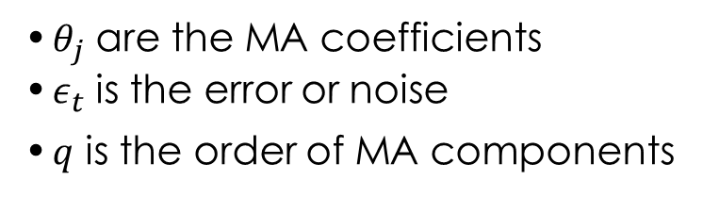
Autoregressive Moving Average (ARMA) Model

Slide 11
Autoregressive Moving Average (ARMA) Model
Key Highlights:
ARMA models capture both the autoregressive patterns and moving average patterns in a time series
Suitable for stationary time series
Advantages:
Captures both past values and residuals for more accurate modeling
Flexible and can model various types of time series
Disadvantages:
Assumes stationarity, which may not hold for real-world data
Selecting appropriate values of p and q can be challenging
Application:
Economic data forecasting

Slide 12
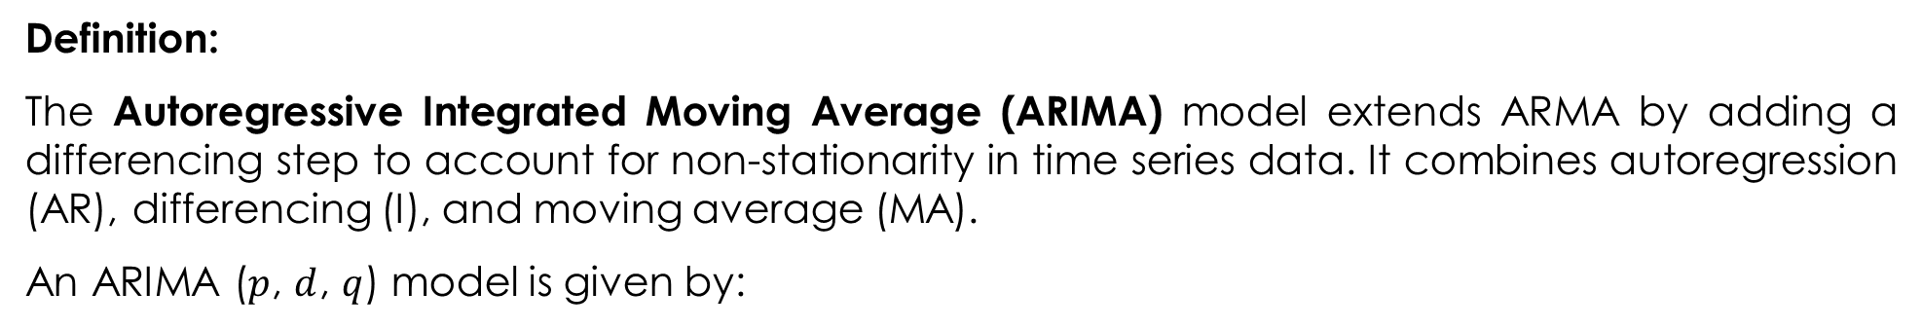
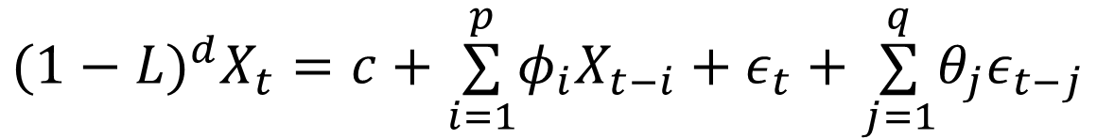
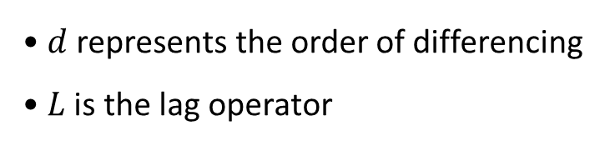
Autoregressive Integrated Moving Average (ARIMA)

Slide 13
Autoregressive Integrated Moving Average (ARIMA)
Key Highlights:
Differencing is used to make a non-stationary series stationary
Can handle both short-term and long-term dependencies
Advantages:
Handles non-stationary data effectively through differencing
Widely applicable for a variety of time series types
Disadvantages:
Selecting appropriate p,d,q values can be complex
The model assumes linear relationships, which may not always be true
Application: Sales forecasting

Slide 14
Pixel CNN
Pixel CNN is a deep learning architecture primarily used for generative tasks, such as generating images pixel by pixel.
It is a type of Convolutional Neural Network (CNN) designed to model the distribution of pixel values in images by treating the pixel values as conditioned on their neighbors. `
Coming back to generative modeling, can the idea of autoregression be applied to Image generation as well?
that means,
We start considering images as a sequence of pixels (flatten the image, then this can make sense)
Using past pixels, predict the next pixel
This is what the idea of PixelCNN is based on.

Slide 15
Pixel CNN
PixelCNN vs CNN?
So, in a conventional CNN, we don’t consider the image as a sequence of pixels, but we take the whole image as input, apply filters using Conv Layer, max/avg pool, and other operations and get to the output.
In the case of PixelCNN, we are doing the same things but using the Masked version on the kernel in Conv Layers.
What is Masking?
We will apply any filter in the Conv Layer to not all values but to a few values hence masking certain values for the model
So if we,
Flatten the image (append each row one behind the other to form a 1D array).
Note: This is just an assumption to make you visualize better, we won’t be flattening the image.
Predict one pixel at a time using the previously predicted pixels. So if you are predicting the 25th pixel in the 1D array, use only the previous 24 pixels already pixel

Slide 16
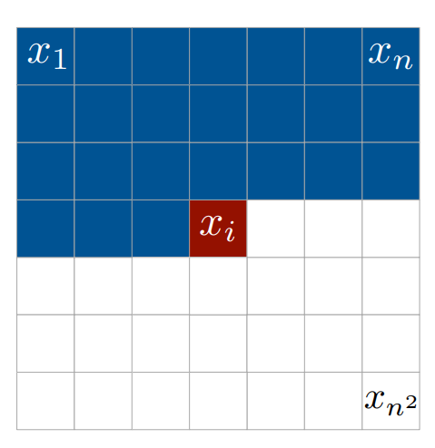
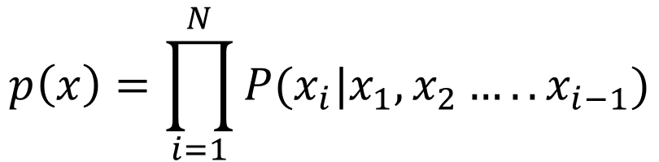
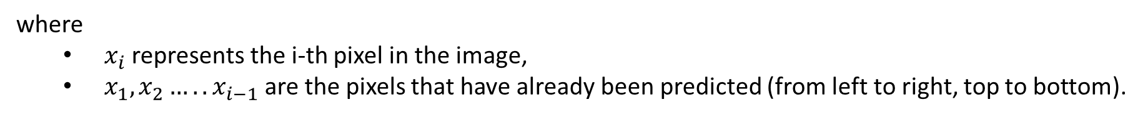
Pixel CNN-working
1. Conditional Distribution
The PixelCNN is a autoregressive model that models the joint distribution of pixels as the product of conditional probabilities:

Slide 17
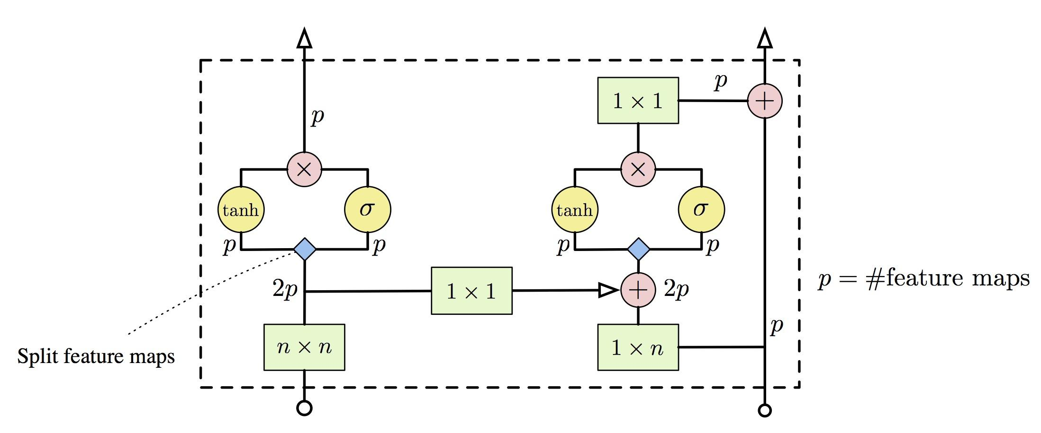
Pixel CNN-Architectural Components

Slide 18
Pixel CNN-working
2. Masked Convolutions for Autoregression
PixelCNN uses causal convolutions (also called "masked convolutions") to ensure that the model doesn’t use future pixels when predicting a pixel.
Convolutional filters are masked so that each filter only takes into account pixels from the previous rows or columns and not future ones.
Masking in Horizontal Convolutions:
A pixel can only be conditioned on the pixels that have already been predicted (i.e., the pixels to its left).
This is achieved by masking the convolutional kernel so that it only interacts with the left-side pixels and the current pixel during prediction.
Masking in Vertical Convolutions:
Similarly, the convolutional kernel is masked in the vertical direction so that each pixel is only conditioned on the pixels above it in the image grid.

Slide 19
Pixel CNN-Architectural Components
a. Convolutional Layers
The core of PixelCNN is based on convolutional layers.
These layers are stacked to form a deep network.
In the original PixelCNN paper (by van den Oord et al.), the network consists of several layers of 2D convolutions with increasing kernel sizes.
b. Gated Activation Units
Instead of using traditional activation functions like ReLU or Sigmoid, PixelCNN uses a more advanced activation function called gated activations.
This is inspired by the Gated Recurrent Unit (GRU), which is typically used in recurrent neural networks (RNNs).
The gated activation function is used to control the flow of information between layers and makes the network more flexible and expressive.

Slide 20
Pixel CNN-Architectural Components
c. Residual Connections
To improve the flow of information and enable the network to learn more complex representations, PixelCNN uses residual connections.
These connections help the model avoid vanishing gradient problems, making it easier to train deeper networks.
d. Output Layer
The final output layer of PixelCNN generates the predicted pixel values.
For image generation tasks, PixelCNN typically uses a softmax function (for discrete pixel values) or a Gaussian distribution (for continuous pixel values).

Slide 21
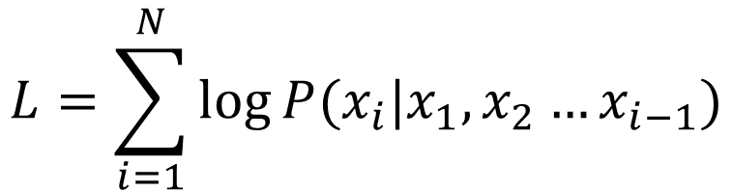
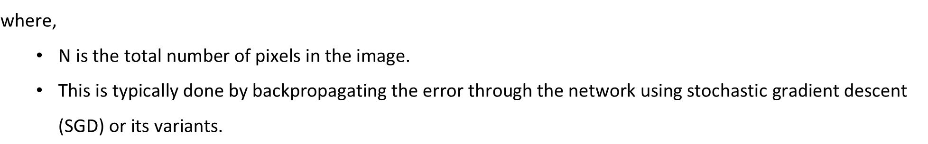
Pixel CNN-Training
Training PixelCNN is done in a standard supervised learning manner.
The model learns to predict each pixel given the previous pixels using maximum likelihood estimation (MLE).
The objective is to maximize the log-likelihood of the observed pixels:

Slide 22
WaveNet
WaveNet is a deep generative model for audio, first introduced by DeepMind in 2016.
Unlike traditional audio synthesis models that rely on handcrafted features or spectral representations (such as spectrograms), WaveNet generates audio directly in the raw waveform domain, pixel by pixel (or sample by sample in the case of audio).
It models the distribution of audio samples conditioned on past samples in an autoregressive manner.
WaveNet has become a crucial model in areas such as speech synthesis, audio generation, and signal processing.

Slide 23
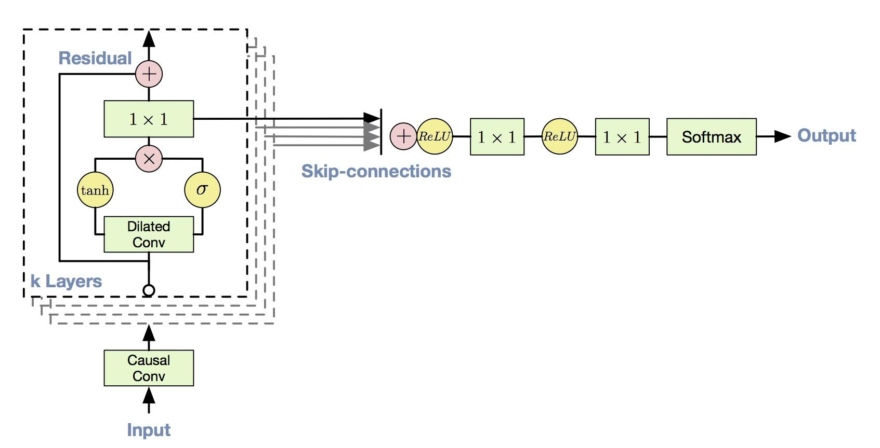
WaveNet-Architecture

Slide 24
WaveNet-Architecture
Key Components:
Causal Convolutions:
WaveNet uses causal convolutions to ensure the autoregressive property (i.e., the model should only use previous audio samples to predict the next sample, not future ones).
This is achieved by applying padding in such a way that the output for time t only depends on times less than or equal to t.
Dilated Convolutions:
Dilated convolutions are used to exponentially increase the receptive field. For example, a standard 1D convolution with a kernel size of 2 and dilation of 2 would cover every 2nd sample in the input sequence, allowing the model to look farther back in time without needing more layers.
By using dilated convolutions, WaveNet can model long-range dependencies in the audio signal, which is critical for generating high-quality, coherent audio.

Slide 25
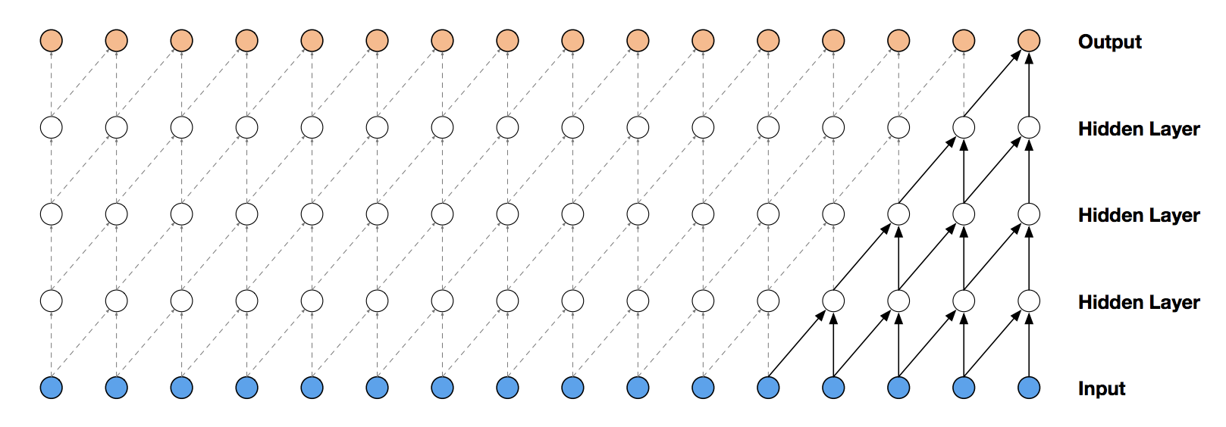
WaveNet-Architecture
Causal Convolutional layers
For training of 1 output sample, 5 input samples are used. Receptive field of this network is 5.

Slide 26
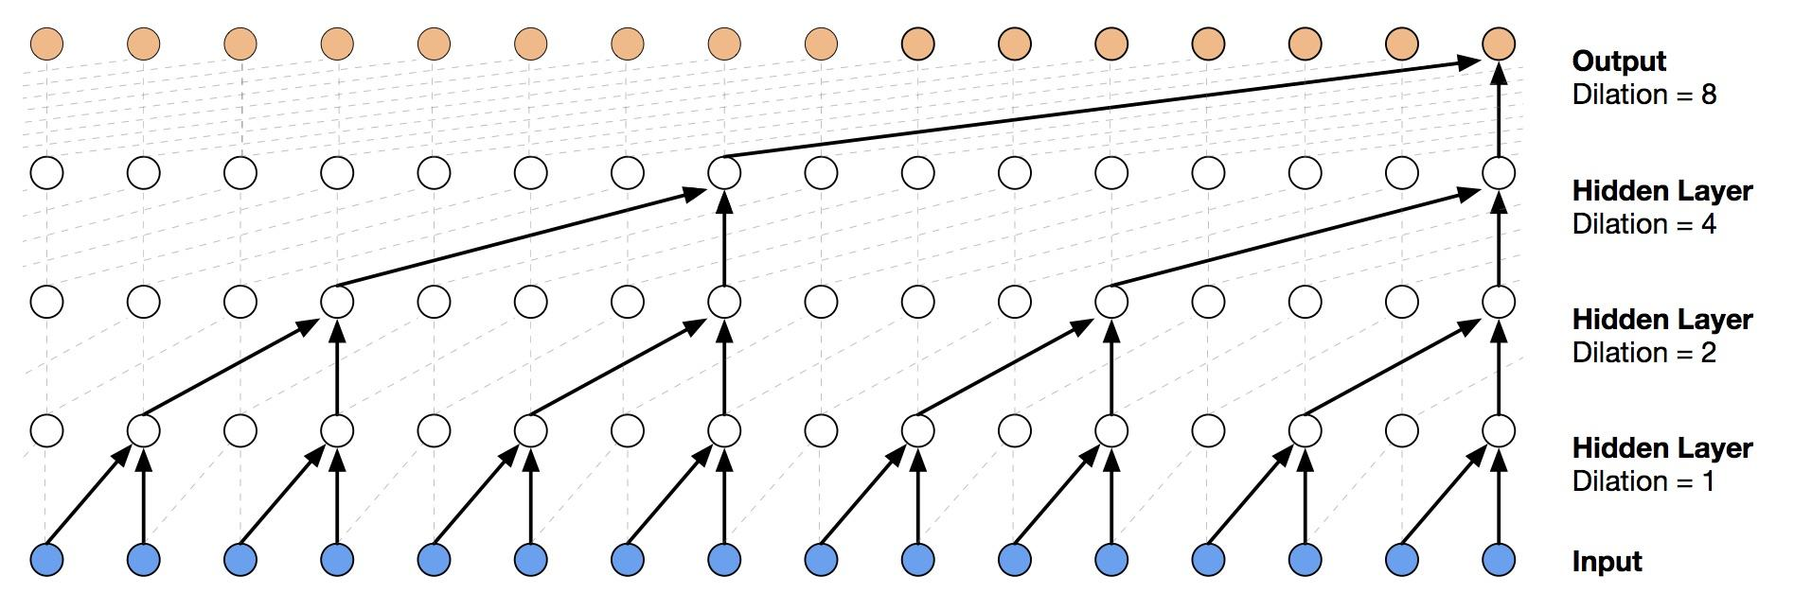
WaveNet-Architecture
Dilated Causal Convolutional layers

Slide 27
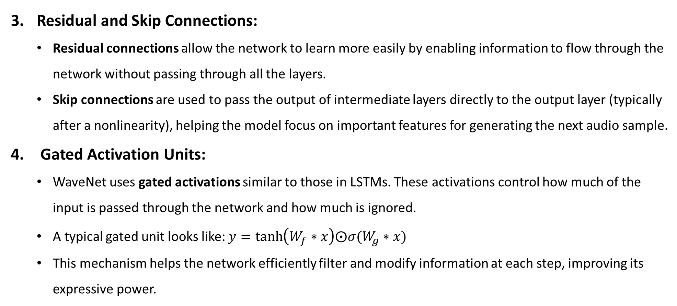
WaveNet-Architecture

Slide 28
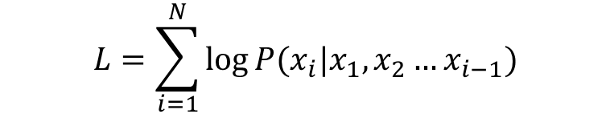
WaveNet-Training and Inference
Training:
WaveNet is typically trained using maximum likelihood estimation (MLE). Given a large dataset of raw audio waveforms, the goal is to maximize the log-likelihood of the observed sequence:
The model is trained using backpropagation and gradient descent (or variants like Adam) to minimize the loss between the predicted and true next audio samples.
Inference (Generation):
In the inference phase, the model generates audio sample by sample. Given an initial seed (e.g., a few audio samples), the model can autoregressively predict the next samples in the sequence.
Since WaveNet is autoregressive, the model’s prediction at time t is conditioned on all previously generated samples. This can make inference slower, but recent techniques like parallel WaveNet or Fast WaveNet help mitigate the inference time.

Slide 29
Thank you

